Slide 1

AM Home Automation
Team Member:-
Rishee Barthakur [IU1682820025]
Internal Guide :-
Prof. Jalpa Poriya

Slide 2
Synopsis

Slide 3
Existing system & problem areas
The smart switch boards having component of for switch is costlier than this product.
You have to replace the whole traditional switch board in order to install a smart switch board at your premises.
Existing system does not have the option for Auto-Manual(Switch).

Slide 4
Need for the system
This device reduces human effort, saves electricity and time.
Using this device the user can access their electronic appliance through phone using internet connection.
If the internet is not working then also the user can operate the board manually.

Slide 5
Proposed System:
Objectives to be fulfilled:
Helping in saving electricity-
This switch board provides the facility to operate your appliances from anywhere in the world using IoT technology. Hence, sometimes if you forget to switch off your Fan or TV, Lights or any other appliances you don’t worry about anything, you just have to press one button from your mobile app which will control the switch board and will make your appliance turned off. This leads saving of electricity and reduces human anxiety when their appliances are turned on and they are out of station.

Slide 6
User Friendly-
In countries like India the people from rural area or we can say the people who don’t have the proper knowledge in operating a mobile app for them, they can use it in the traditional way the way all the switch boards are operated .Hence we can say that this smart switch board can be operated by the people or our generation and our older generation who might have a little knowledge compared to us in smart technologies. This point focus village area
Helping in reducing human effort-
The user can Turn ON or Turn OFF lights, fans etc. from sitting on a single place.

Slide 7
Preambles

Slide 8
Project description
The Home automation AM board is a smart IoT based switch board having four switching components which can be installed in Flats, Apartments or Offices to operated your electrical devices like lights, fans ACs wirelessly through your mobile phone as well in a traditional manner. This device is cheap and user friendly compared to those smart switch board which are available in Amazon or any other E-Commerce site.

Slide 9
System Modules
Hardware side:
Arduino board
ESP8266
Relay module
DC voltage converter
Male-Female connecting wires
One switch board
Application side:
Register
Log In
Dashboard
Select board
On (For any four appliances)
Off (For any four appliances)
Settings
Log Out

Slide 10
Technical description
Hardware Requirements:
Arduino board (IC)
ESP8266
Four relay module
One switch board
Four one way switches
One two way switch
Android phone
Software Requirements:
NoSQL for the database
Android as in Operating System
At least Marshmallow
RAM 200 MB Min

Slide 11
Technology which we are going to use :
Internet of Things
Mobile technology
Programming Language:
C++
Java

Slide 12
Diagrams

Slide 13
USE CASE diagram

Slide 14
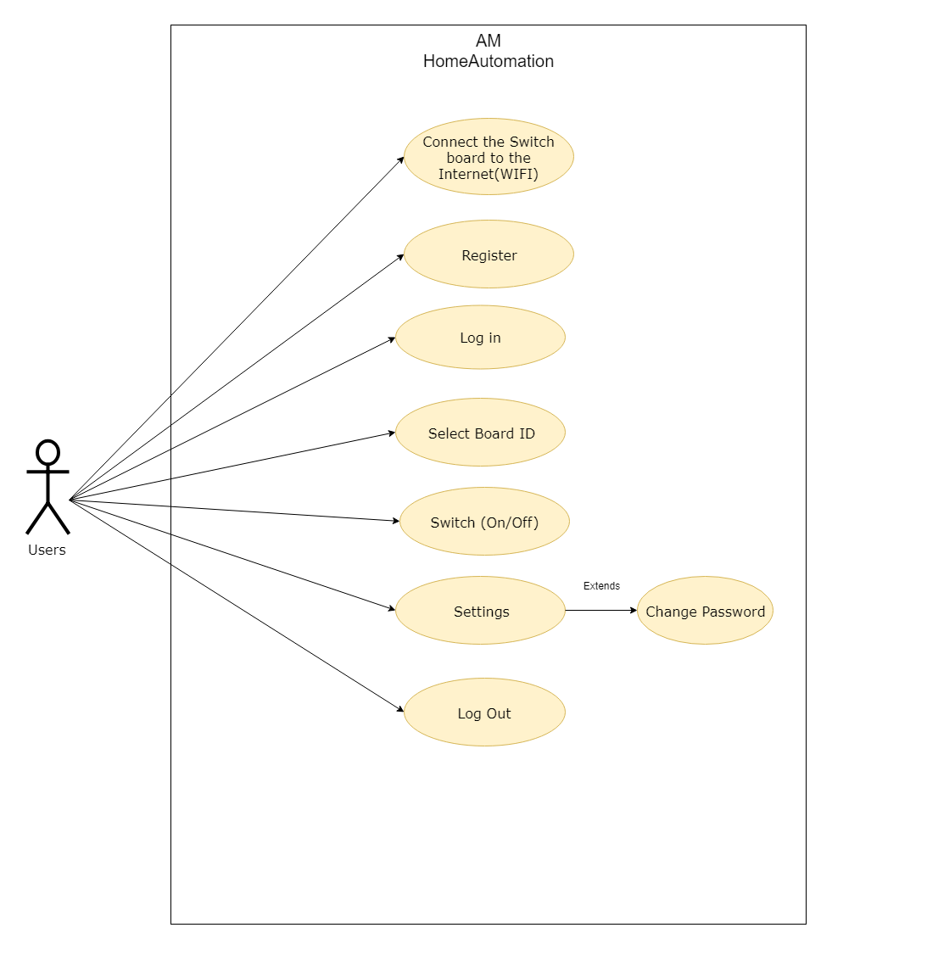

Slide 15
System Flow Chart

Slide 16
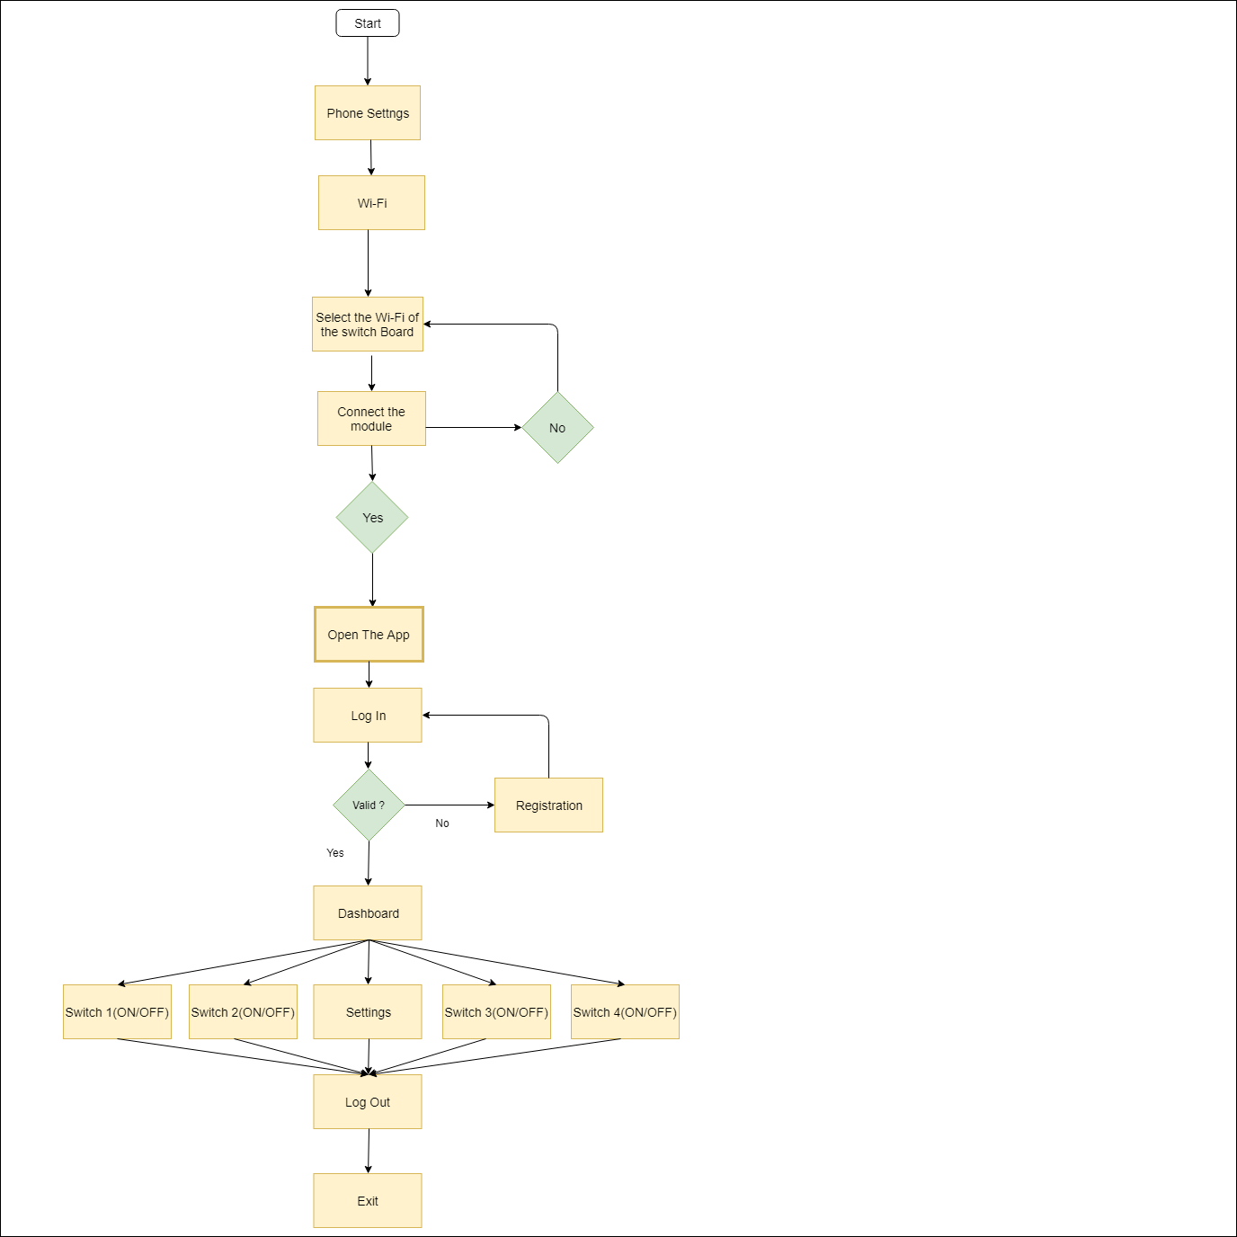

Slide 17
Activity Diagrams

Slide 18
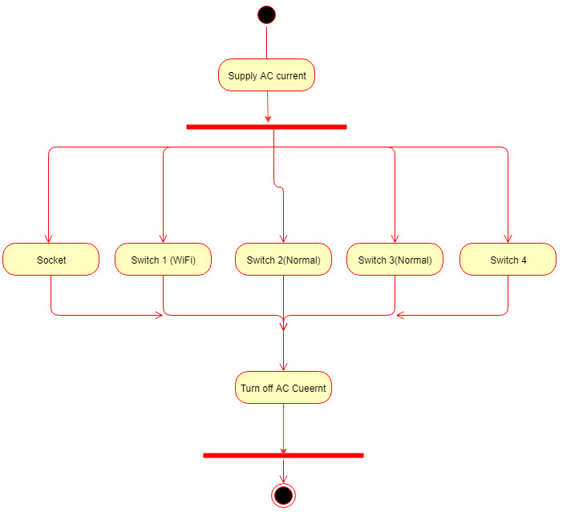
Hardware side :

Slide 19
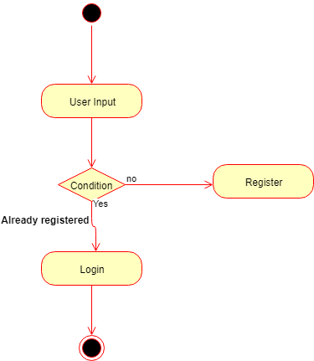
Application side: Registration

Slide 20
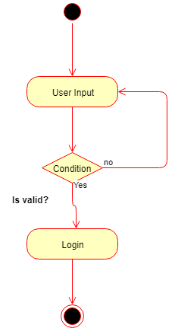
Login

Slide 21
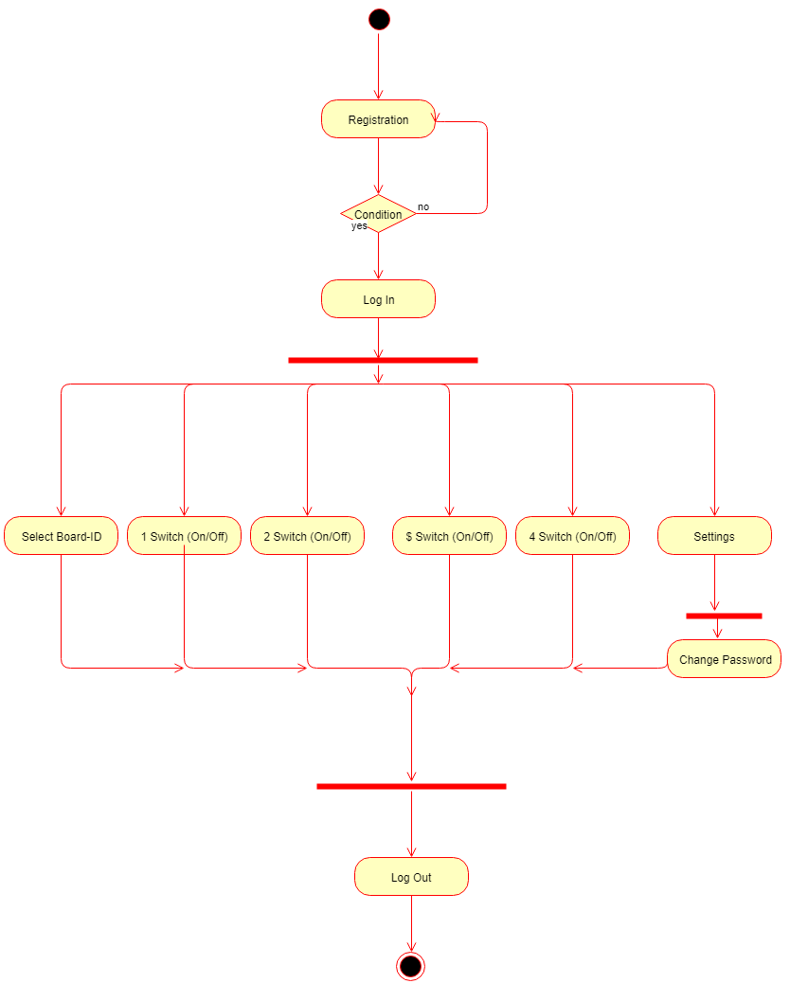
AM Home Automation

Slide 22
Class Diagrams

Slide 23
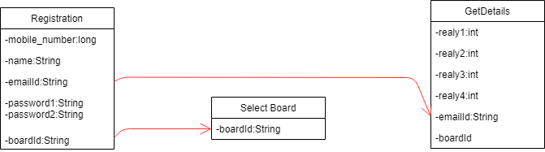

Slide 24
Data Dictionary

Slide 25
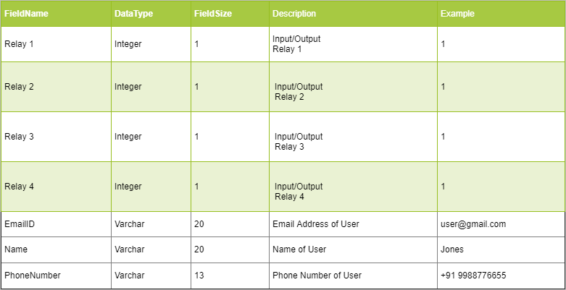

Slide 26
Representation of Modules Hardware

Slide 27
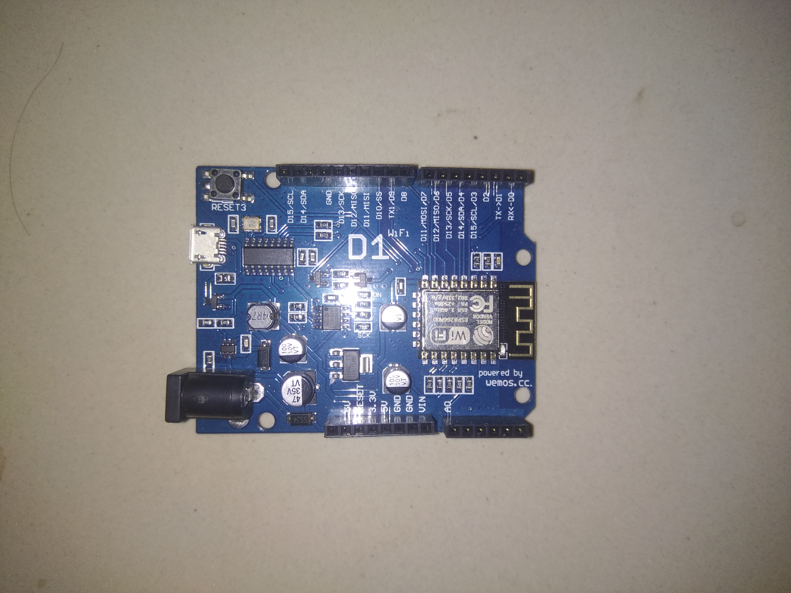
Arduino D1

Slide 28
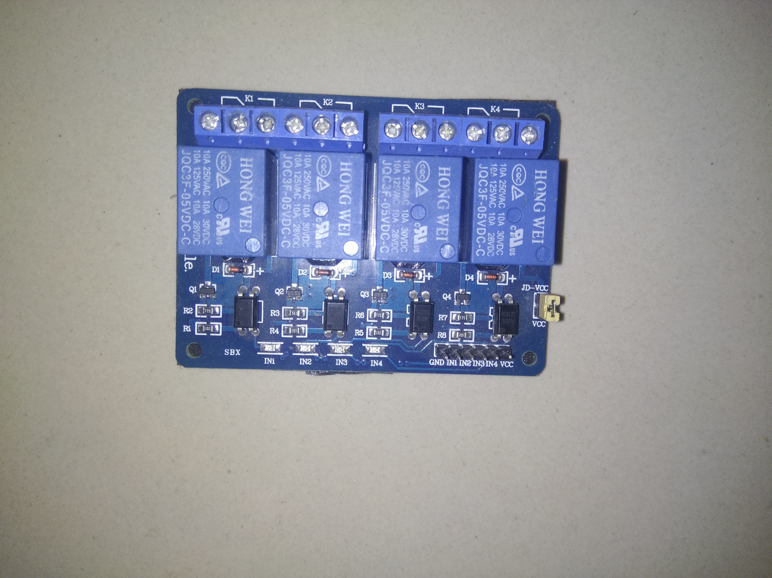
4 Component Relay

Slide 29
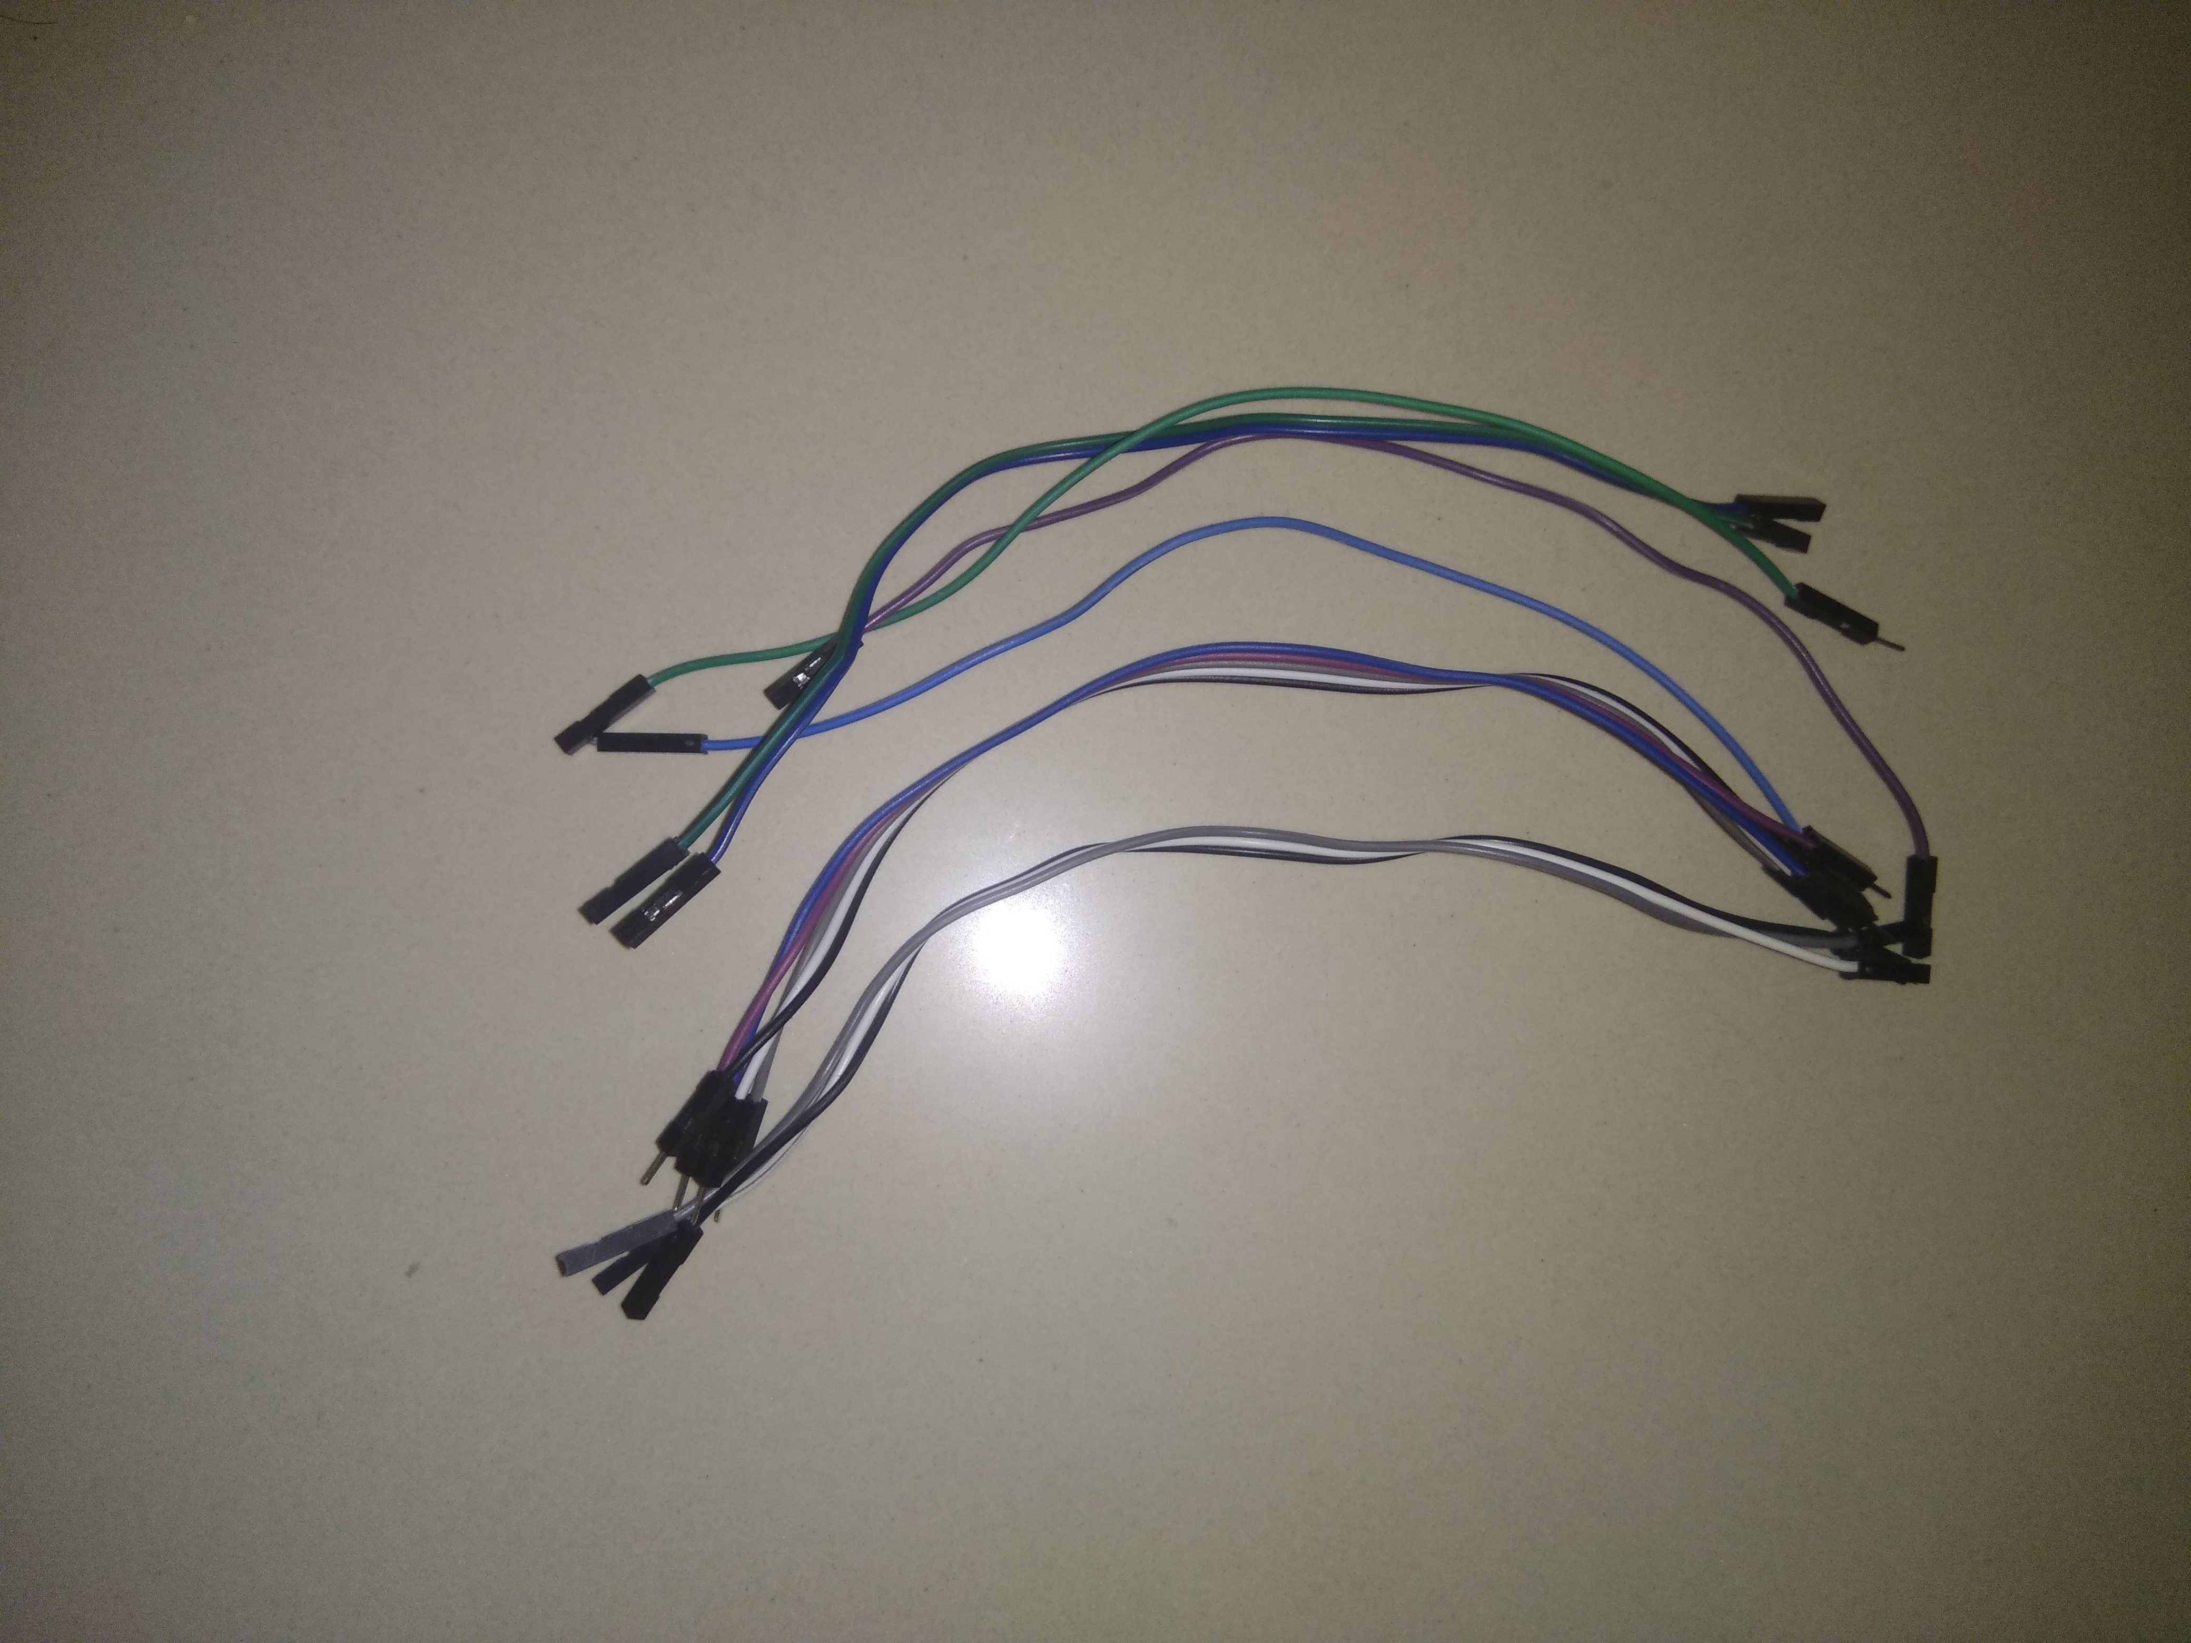
Connecting wires

Slide 30
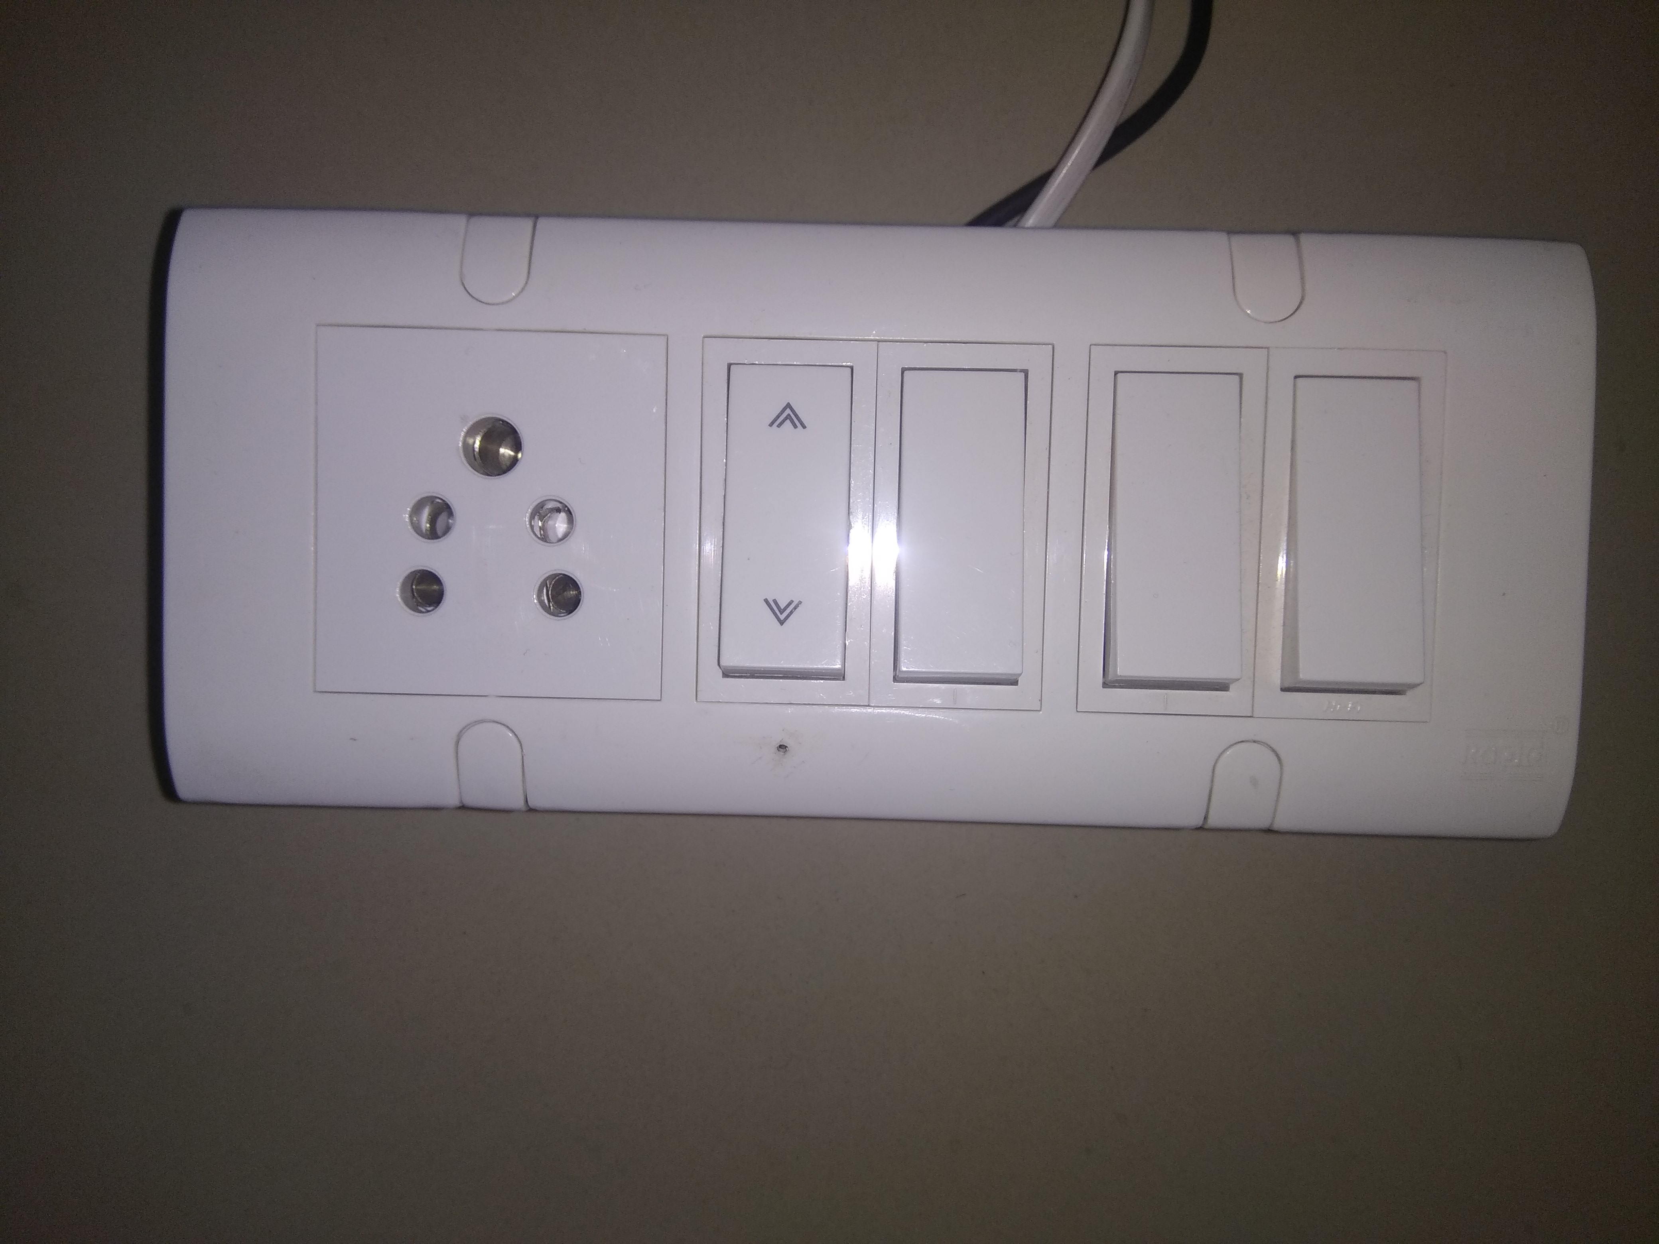
One Switch Board

Slide 31
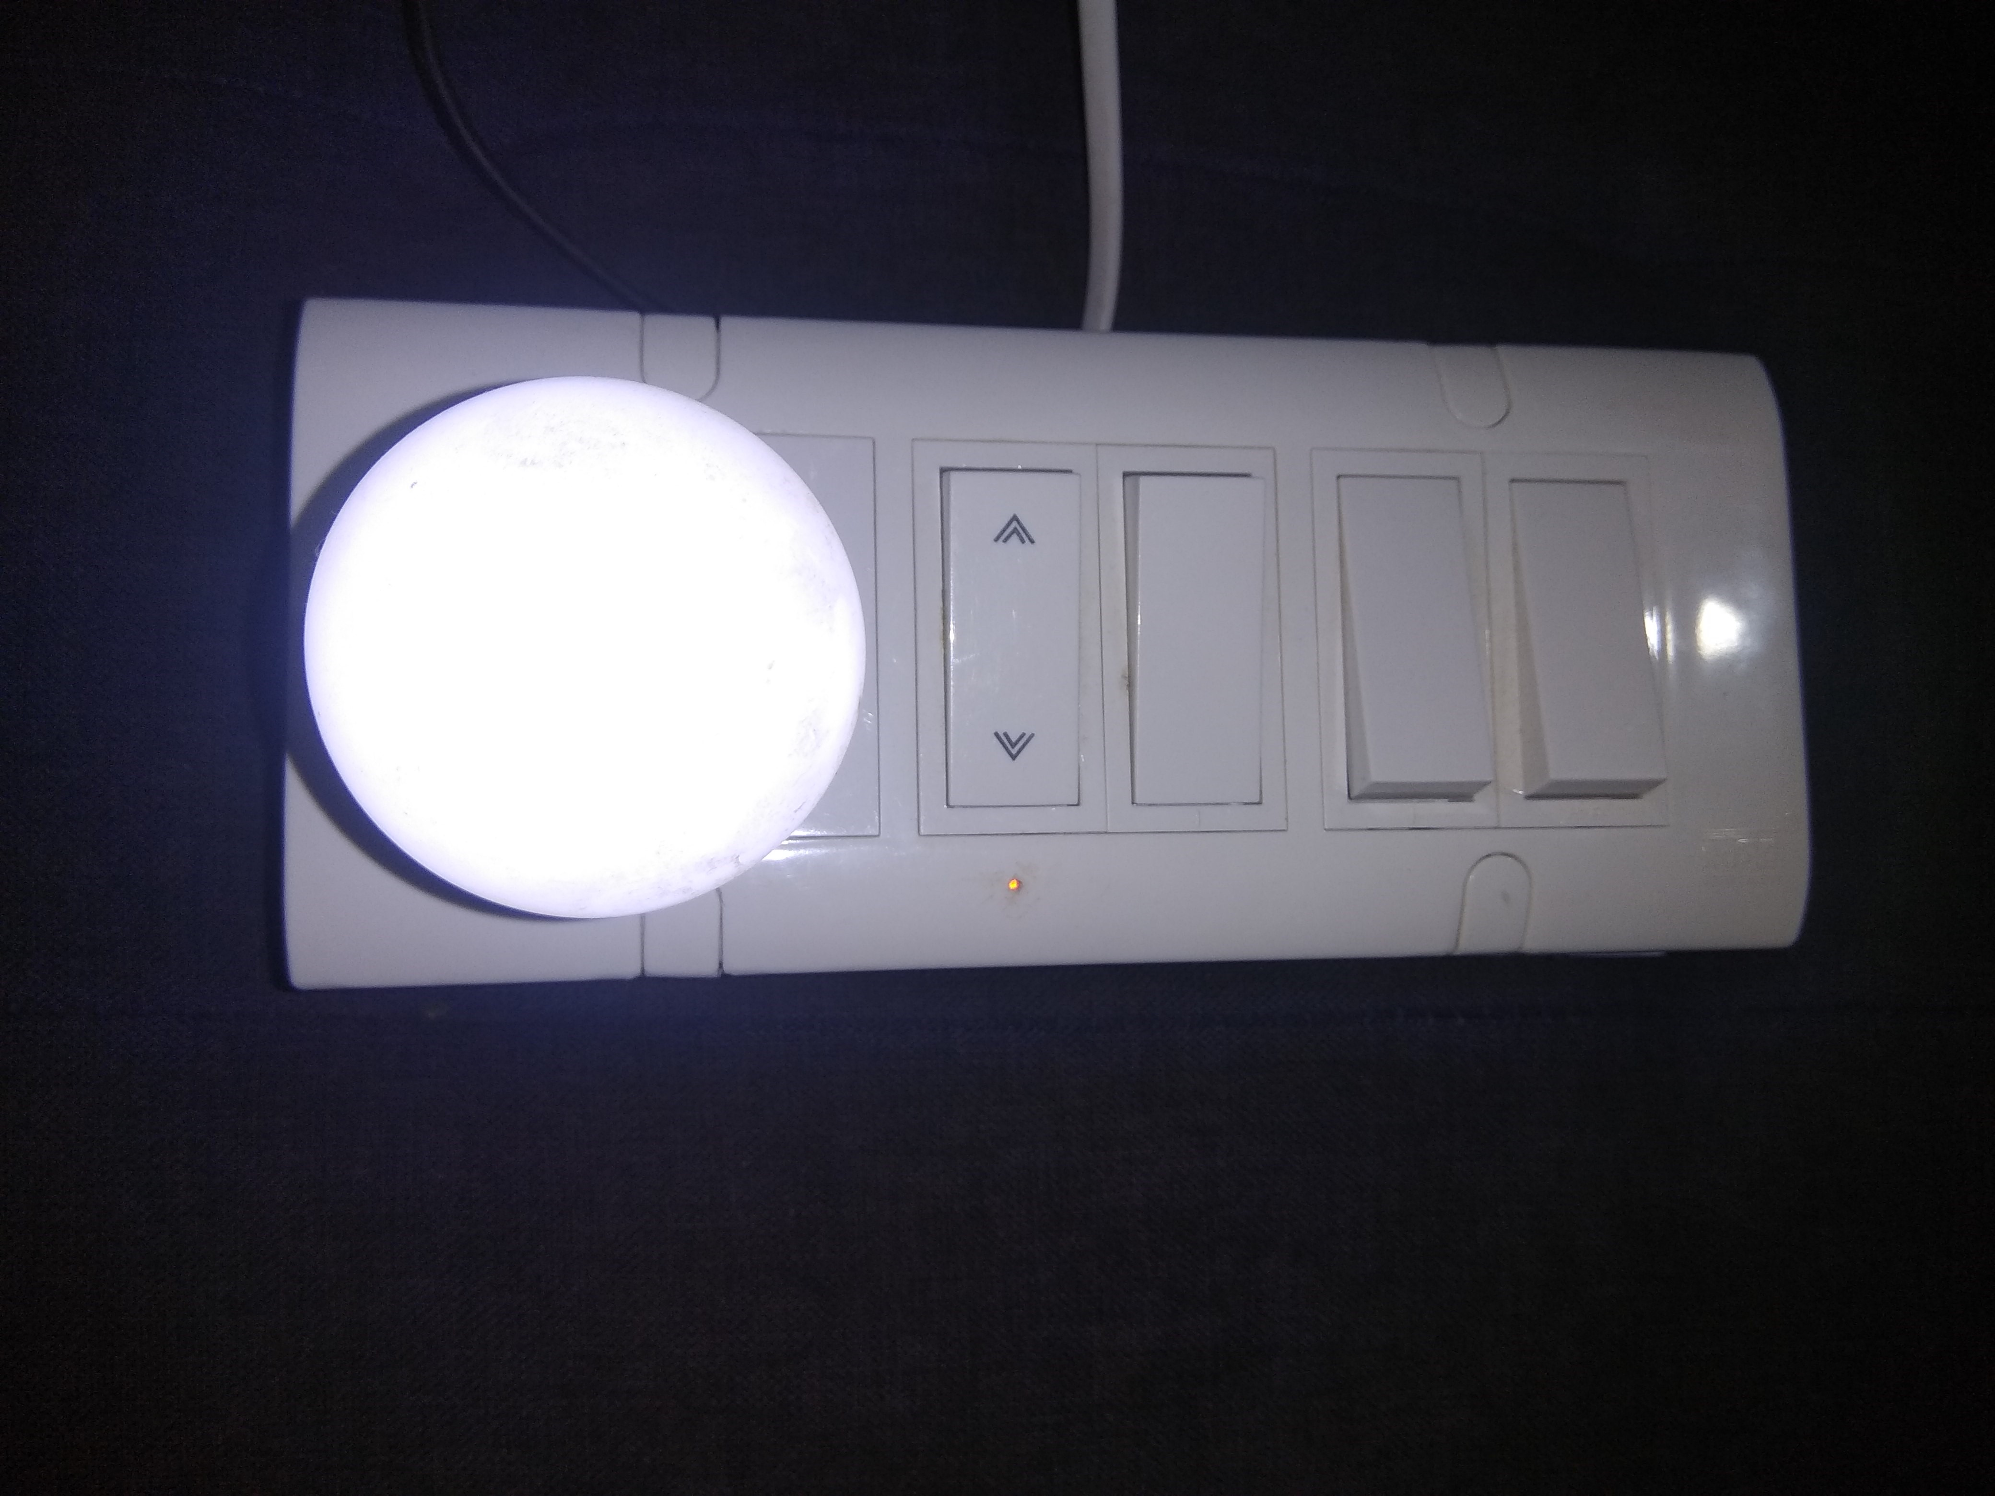
The final working model

Slide 32
Representation of Modules The Mobile App & WiFi

Slide 33
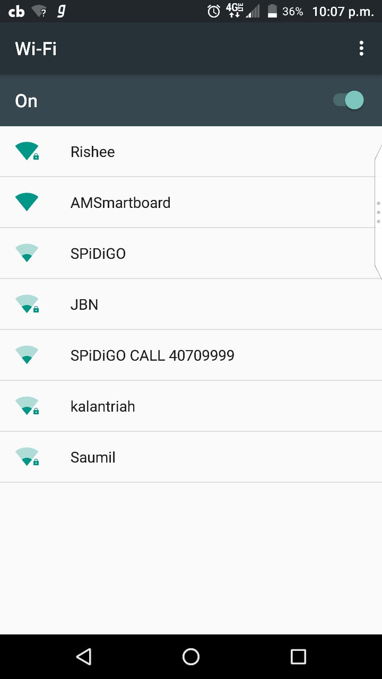
WiFi connection for the switch board

Slide 34
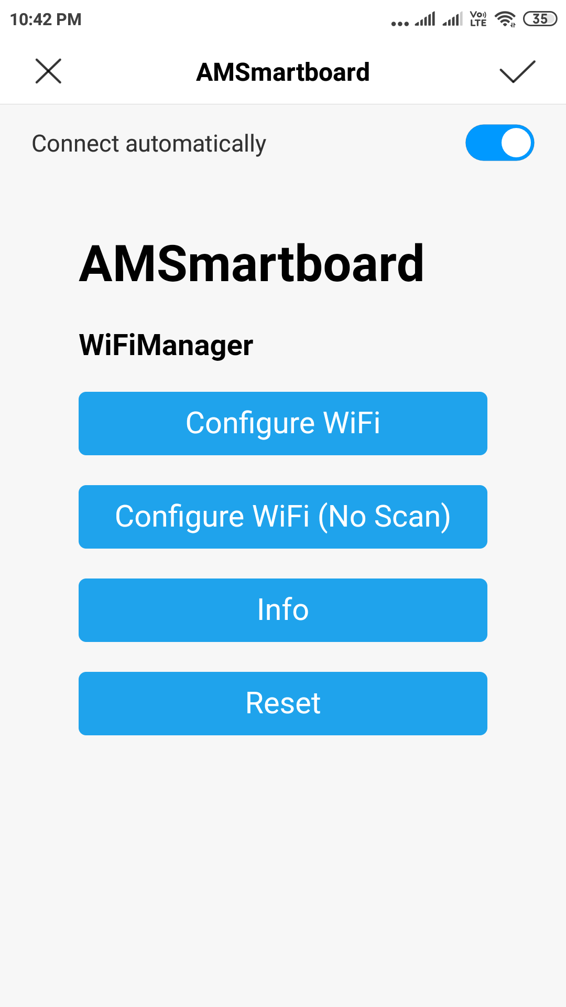

Slide 35
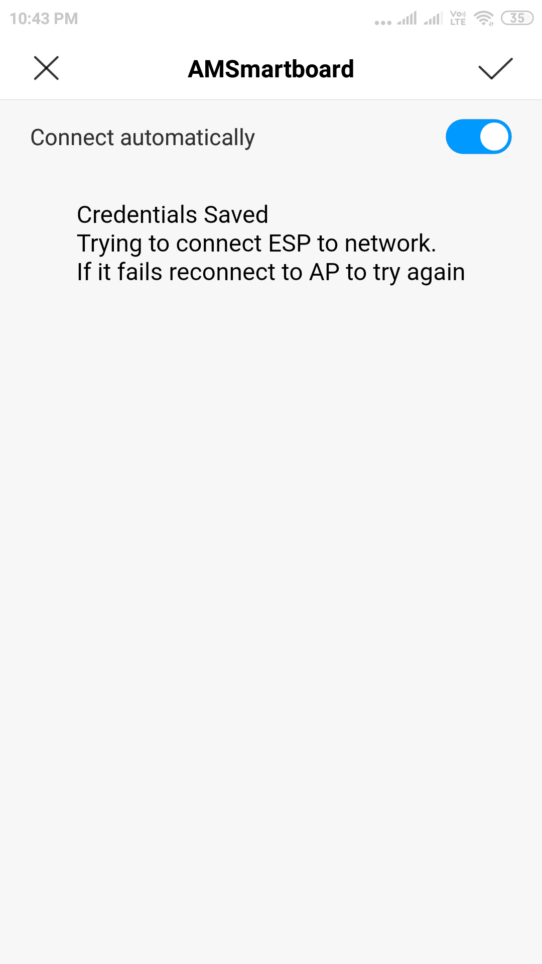

Slide 36
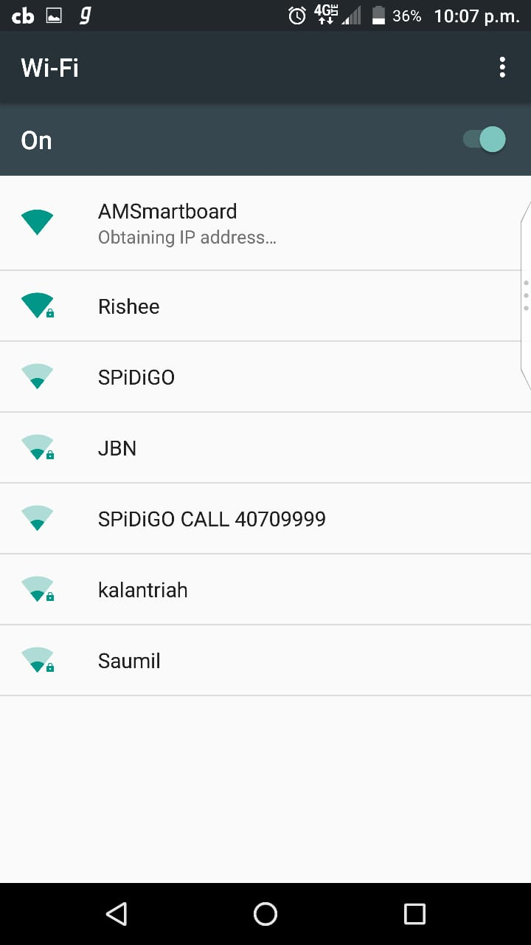

Slide 37
Open the AM SmartBoard

Slide 38
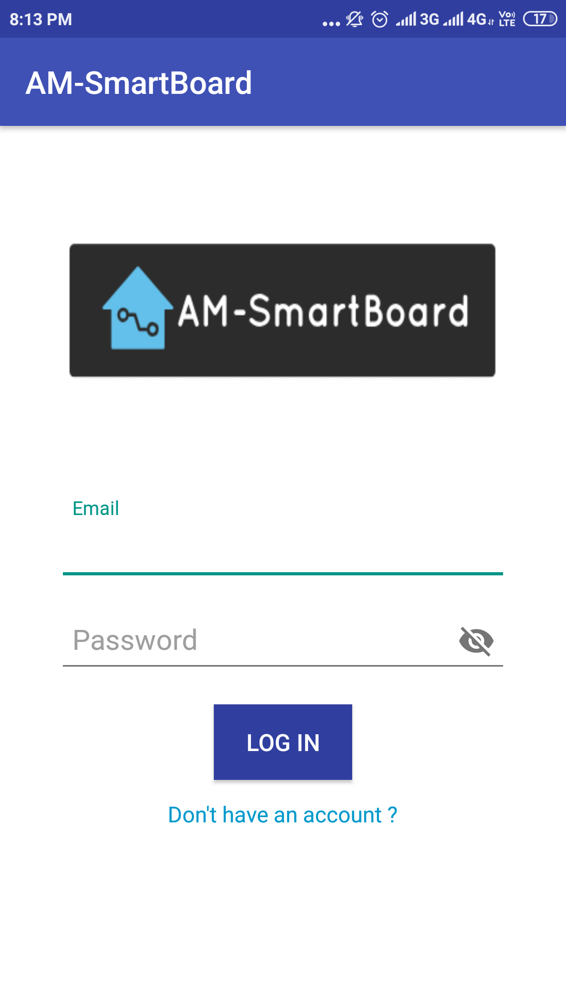
Login

Slide 39
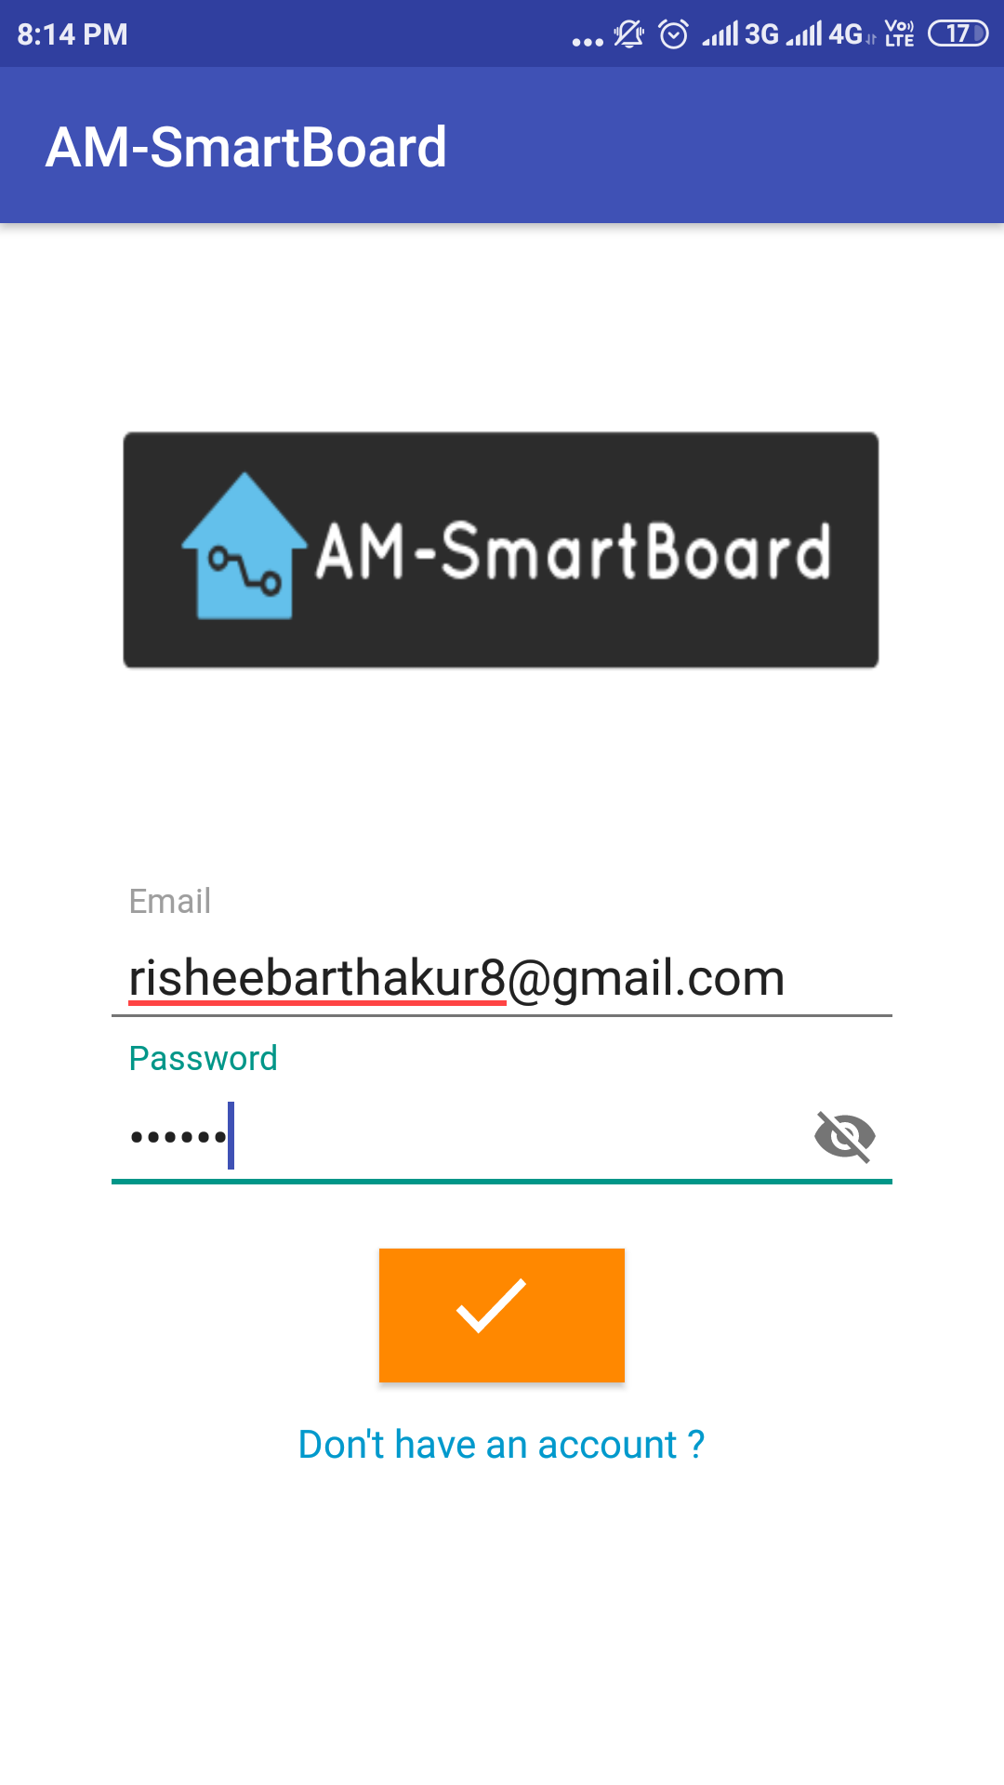
Login

Slide 40
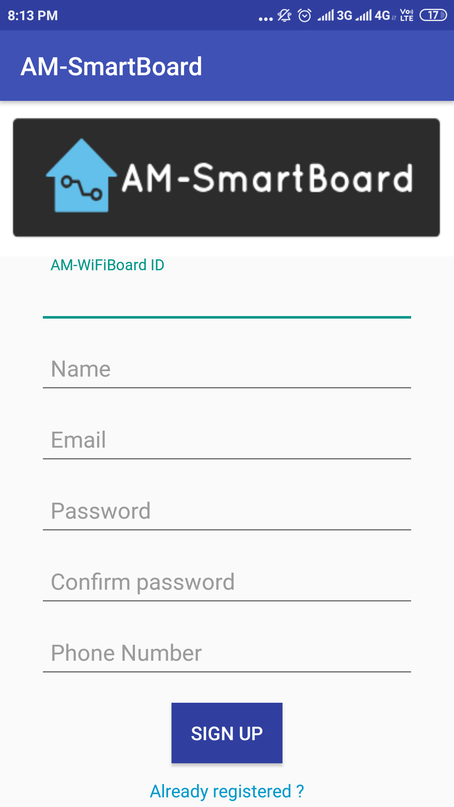
Registration

Slide 41
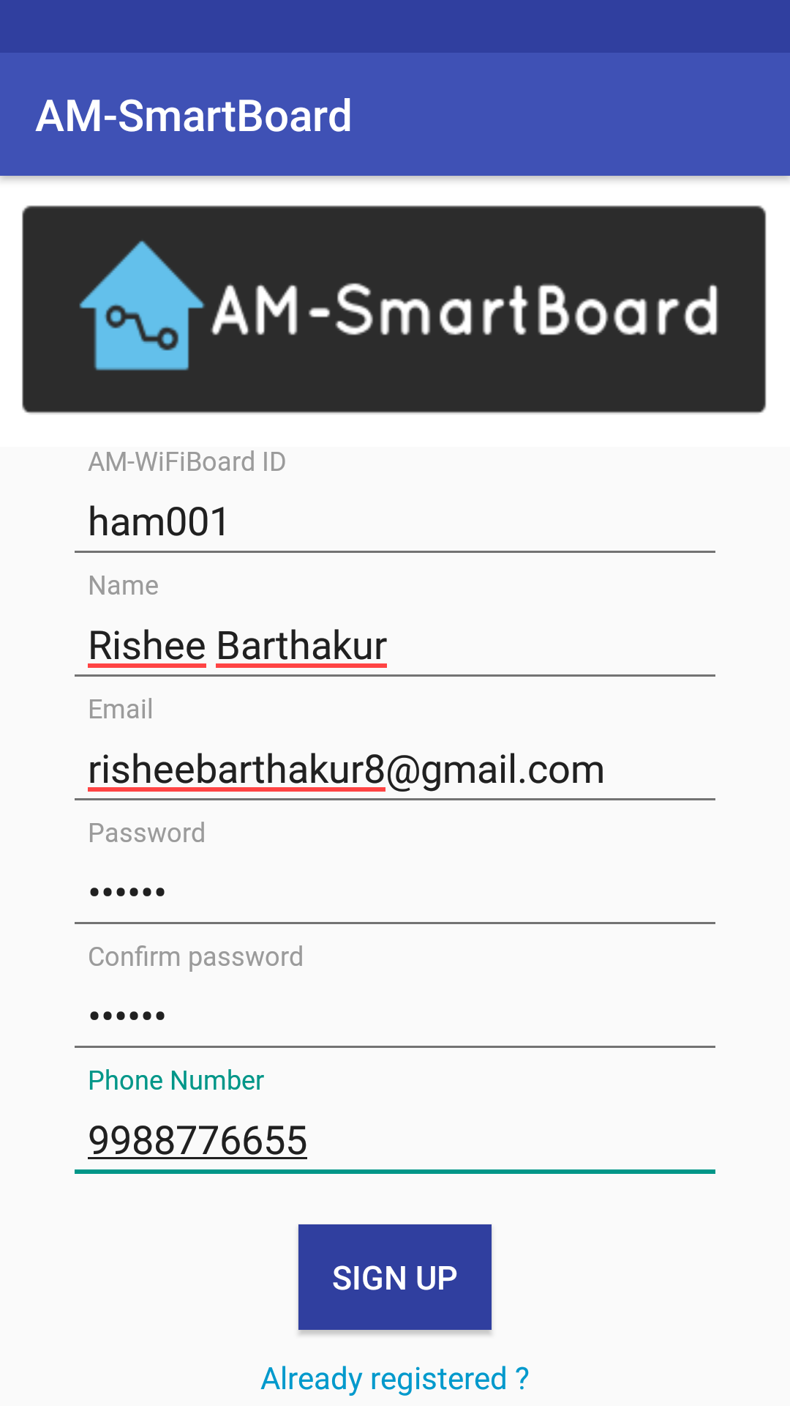
Registration

Slide 42
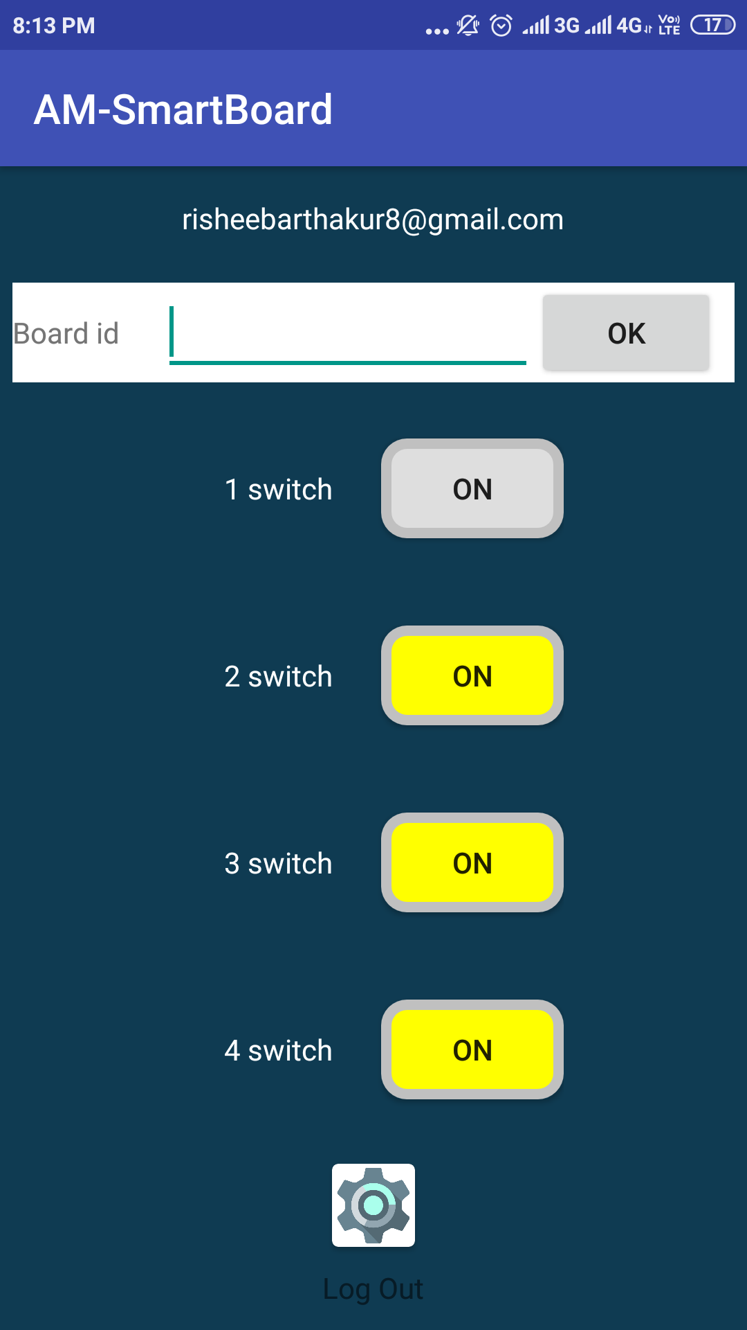
Dashboard

Slide 43

Dashboard

Slide 44
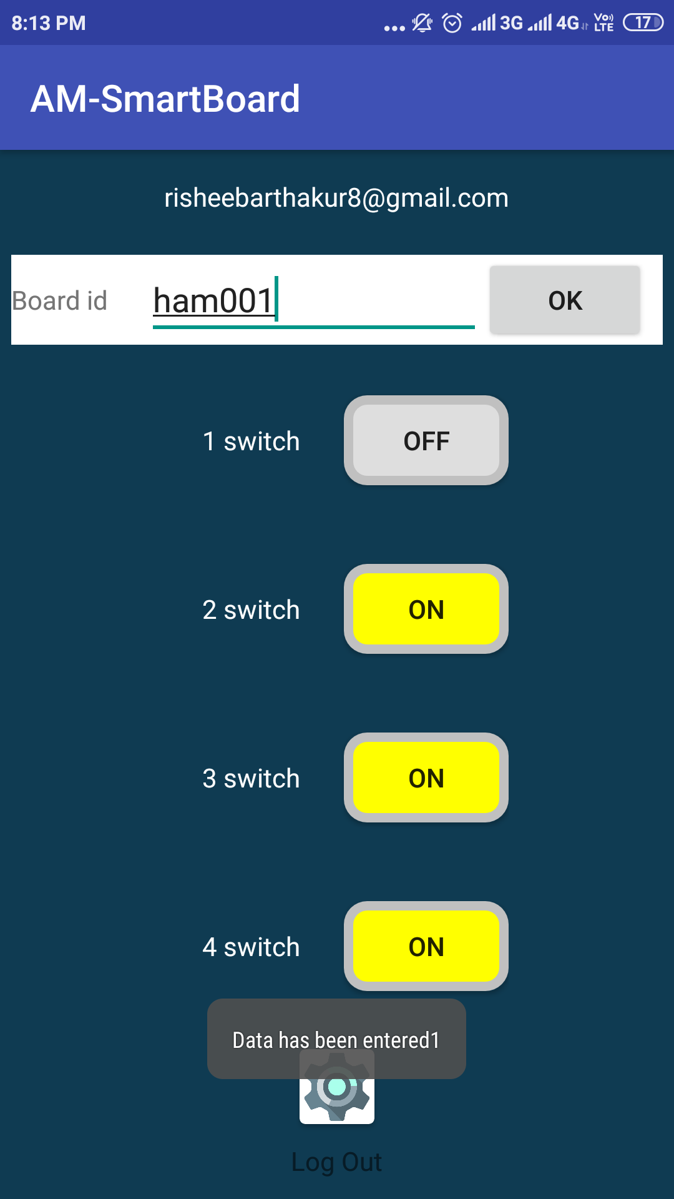
Dashboard

Slide 45
Test Cases

Slide 46
For Login
Sr No | Test Case ID | Objective | Precautions | Steps | Test Data | Expected Result | Actual result
1 | TC_001 | To check log in functionality with valid Email & password | App should be installed | Open the app | AM HomeAutomation | User should see the app | Same as expected result
2 |  |  | User should be registered | Enter login credential | EmailId: risheebarthakur8@gmail.com Password :***** | User should be able to click on login | Same as expected result
3 |  |  | User should be registered | Click on login |  | User should be able to login & redirected to the Dashboard | Same as expected result
4 |  | If the user is not registered |  | Click on “Don’t have an account” | Page redirect | User should move to the registration page | Same as expected result

Slide 47
For Registration
Sr No | Test Case ID | Objective | Precautions | Steps | Test Data | Expected Result | Actual result
1 | TC_002 | To check log in functionality of registration | App should be installed | Open the app | AM HomeAutomation | User should see the app | Same as expected result
2 |  |  |  | Fill the registration form with Board ID & user detail | AM-WIfiBoard ID,Name,Email,Password,Confirm Password,Phone Number & the password should match | User should be able to click on login | Same as expected result
3 |  |  |  | Click on Registered |  | User should be able to register & redirected to the Login page | Same as expected result

Slide 48
For Dashboard
Sr No | Test Case ID | Objective | Precautions | Steps | Test Data | Expected Result | Actual result
1 | TC_003 | User’s Email ID should be | User must be logged in |  | Showing Email ID | User’s Email ID should be | Same as expected result

Slide 49
For Select Board ID
Sr No | Test Case ID | Objective | Precautions | Steps | Test Data | Expected Result | Actual result
1 | TC_003_01 | Selecting the Switch board | User must be logged in | Enter the Board ID | Board ID | Switch board should be selected | Same as expected result
2 |  |  | User must be logged in | Click OK | Board ID | Switch board will be selected and the ID will be shown in toast at the bottom | Same as expected result

Slide 50
For Switch 1
Sr No | Test Case ID | Objective | Precautions | Steps | Test Data | Expected Result | Actual result
1 | TC_003_02 | The light should be turned on | User must be logged in, Switch board should be connected to the AC current and the WIFI should be connected to the switch board | Press the ON button | Light and the ON button | The light should turn on and the ON should be converted to OFF | Same as expected result
2 |  | The light should be turned off | User must be logged in, Switch board should be connected to the AC current and the WIFI should be connected to the switch board | Press the OFF button | Light and the OFF button | The light should turn off and the OFF should be converted to ON | Same as expected result

Slide 51
For Switch 2
Sr No | Test Case ID | Objective | Precautions | Steps | Test Data | Expected Result | Actual result
1 | TC_003_03 | The light should be turned on | User must be logged in, Switch board should be connected to the AC current and the WIFI should be connected to the switch board | Press the ON button | Light and the ON button | The light should turn on and the ON should be converted to OFF | Same as expected result
2 |  | The light should be turned off | User must be logged in, Switch board should be connected to the AC current and the WIFI should be connected to the switch board | Press the OFF button | Light and the OFF button | The light should turn off and the OFF should be converted to ON | Same as expected result

Slide 52
For Switch 3
Sr No | Test Case ID | Objective | Precautions | Steps | Test Data | Expected Result | Actual result
1 | TC_003_04 | The light should be turned on | User must be logged in, Switch board should be connected to the AC current and the WIFI should be connected to the switch board | Press the ON button | Light and the ON button | The light should turn on and the ON should be converted to OFF | Same as expected result
2 |  | The light should be turned off | User must be logged in, Switch board should be connected to the AC current and the WIFI should be connected to the switch board | Press the OFF button | Light and the OFF button | The light should turn off and the OFF should be converted to ON | Same as expected result

Slide 53
For Switch 4
Sr No | Test Case ID | Objective | Precautions | Steps | Test Data | Expected Result | Actual result
1 | TC_003_05 | The light should be turned on | User must be logged in, Switch board should be connected to the AC current and the WIFI should be connected to the switch board | Press the ON button | Light and the ON button | The light should turn on and the ON should be converted to OFF | Same as expected result
2 |  | The light should be turned off | User must be logged in, Switch board should be connected to the AC current and the WIFI should be connected to the switch board | Press the OFF button | Light and the OFF button | The light should turn off and the OFF should be converted to ON | Same as expected result

Slide 54
For Settings
Sr No | Test Case ID | Objective | Precautions | Steps | Test Data | Expected Result | Actual result
1 | TC_003_06 | Go to the setting page | User must be logged in | Press the Settings button | Settings | Routed to settings page | Same as expected result
2 | TC_003_06_1 | Change password | User should be in the Settings page | Enter the new password | Setting new password | Password is changed | Same as expected result

Slide 55
For Log Out
.
Sr No | Test Case ID | Objective | Precautions | Steps | Test Data | Expected Result | Actual result
1 | TC_003_07 | User must logged out and redirected to the home page i.e. Login page | User must be logged in | Press the Logout button | Logging out | User is logged out and redirected to the home page i.e. Login page | Same as expected result

Slide 56
Conclusion
This device is an innovative tool which can be access by everyone. The future is going to be
more advance at that time the product like this will have a need for people.
Future Enhancement
Technology has become need for people these days. And this product is something which
reduces human effort and helps in securing electronic appliances. So this project shows a wide scope in coming days though such devices are being used by people these days.

Slide 57
Bibliography
www.google.com
www.stackoverflow.com
www.arduino.cc
www.developer.android.com

